Slide 1

ME 200 Thermodynamics
Lecture 08 – Equations of State

Slide 2
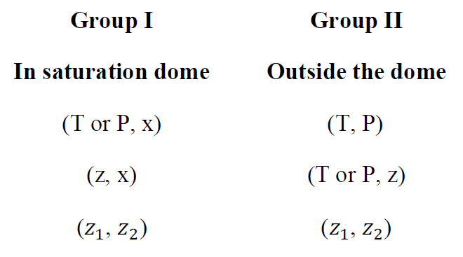
To Find Properties
direct
direct
trial & error
direct
trial & error
direct, but usually needs double interpolation
(T or P, z) direct
Notes:
Outside of saturated dome, x means NOTHING

Slide 3
Methods for Determining States
Tables
Figures
Equation of States (EOS)
Computer
Notes:
1 minute to THONK

Slide 4
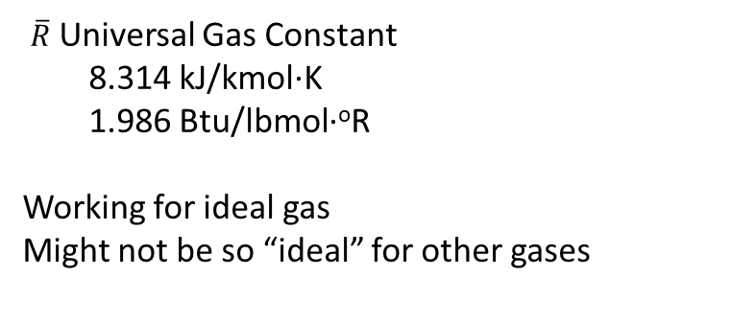

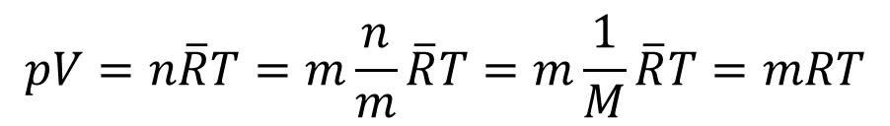
Equations of States (EOS)
Ideal Gas Model
$$pV=n\overline{R}T=m\frac{n}{m}\overline{R}T=m\frac{1}{M}\overline{R}T=mRT$$
$$pV=mRT⇒pv=RT$$
$\overline{R}$Universal Gas Constant
8.314 kJ/kmol·K
1.986 Btu/lbmol·ºR
Working for ideal gas
Might not be so “ideal” for other gases
Notes:
Molar vs mass basis

Slide 5
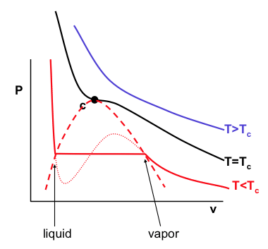
When do you use ideal gas?
Choose the region where you are most likely to find a substance behaving as an ideal gas.
A.
B.
D.
C.
Notes:
1 minute

Slide 6
When do you use ideal gas?
Choose the region where you are most likely to find a substance behaving as an ideal gas.
Usually, for p < p_{c} and T > T_{c}, ideal gas assumption is reasonable.
A.
B.
D.
C.
Notes:
Negligible volume, obey newtons law, perfect elastic conditions
Needed to be energetic – need to be somewhat energetic and enough space between them:
Pressure has to be less than critical pressure and higher than critical temperature has to be D.

Slide 7


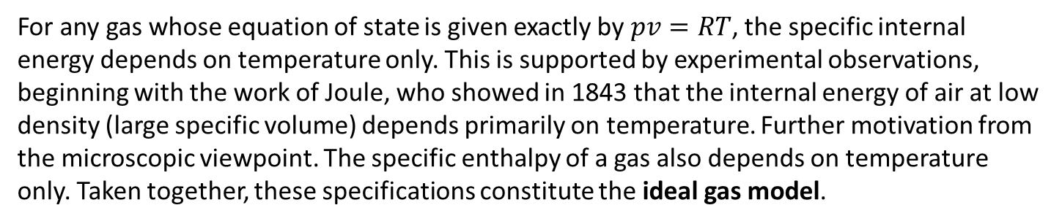

Equations of States (EOS)
Best Feature of Ideal Gas Model
$$pv=RT$$
$$u=u(T)$$
$$h=h\left(T\right)=u\left(T\right)+RT=u+pv$$
For any gas whose equation of state is given exactly by $pv=RT$, the specific internal energy depends on temperature only. This is supported by experimental observations, beginning with the work of Joule, who showed in 1843 that the internal energy of air at low density (large specific volume) depends primarily on temperature. Further motivation from the microscopic viewpoint. The specific enthalpy of a gas also depends on temperature only. Taken together, these specifications constitute the ideal gas model.
Notes:
Only depends on temperature instead of everything else and life is much easier.

Slide 8
Example
Find the value of specific volume of steam at 400 ºC and 2.5 MPa.
From Table A-4
Notes:
Steam can occasionally be considered ideal gas

Slide 9
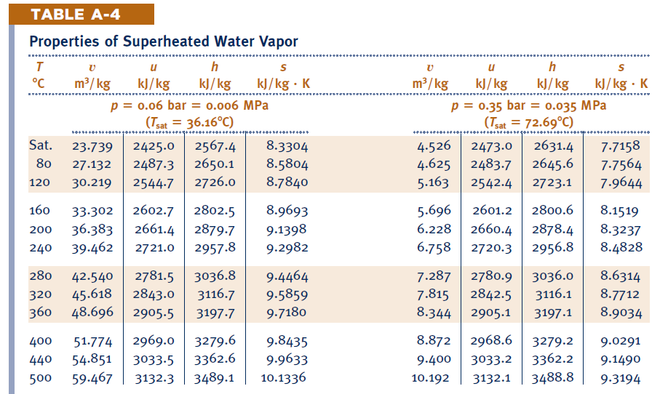


Ideal Gas Model
$$u=u\left(T\right)$$
$$h=h\left(T\right)=u\left(T\right)+RT=u+pv$$

Slide 10
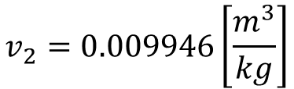
Example
Find the value of specific volume of steam at 400 ºC and 20 MPa.
Ideal gas model
Table A-4
$$v_{2}=0.009946\left[\frac{m^{3}}{kg}\right]$$

Slide 11
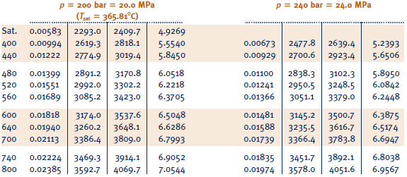


Example
Find the value of specific volume of steam at 400 ºC and 20 MPa.
$$u≠u(T)$$
$$h≠f(T)$$

Slide 12
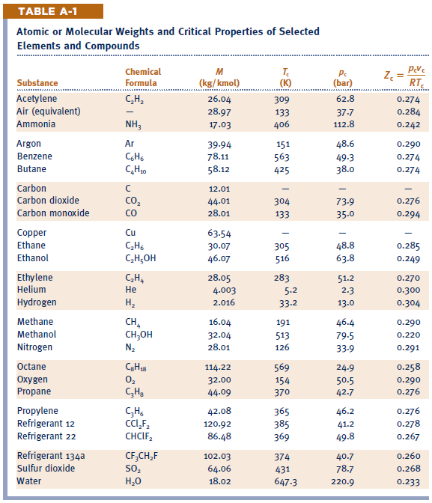
Critical Properties
Notes:
This can tell you if you are going a bit too far off your pressures and temperatures and if it is not valid at that point
Look at Air, greater than temperature and lower than pressure

Slide 13
Example
Find the value of specific volume of steam at 400 ºC and 20 MPa.
2.5 Mpa?
Usually, for p < p_{c} and T > T_{c}, ideal gas is reasonable.
A.
B.
For water,
p_{c} = 22.06 MPa
T_{c} = 647.1 K
D.
C.
Notes:
Point 1 is not good, but for 2.5 Mpa, it is within the region

Slide 14
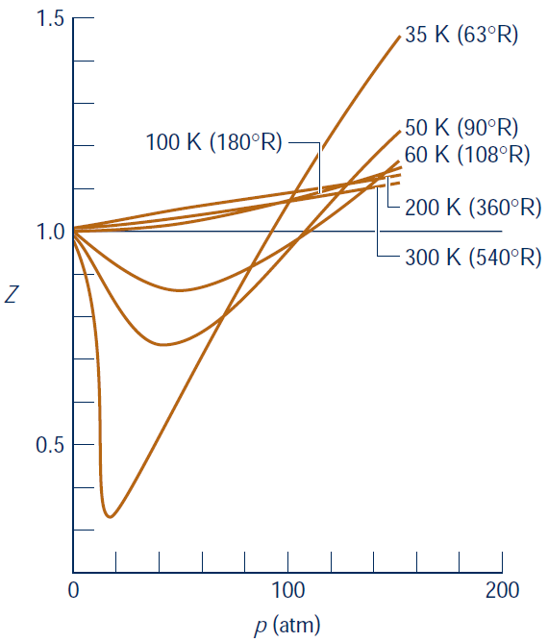
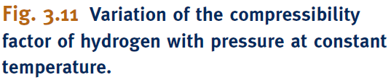


Equations of States (EOS)
Compressibility Factor
$$Z=\frac{pv}{RT}=$$
compressibility factor
$$Z=1⇒$$
a gas is “perfect”, “ideal”
A good measurement of the
“idealness” of a real gas is
its deviation from 1 in terms
of the compressibility factor.
Notes:
In most usual conditions (for instance at standard temperature and pressure), most real gases behave qualitatively like an ideal gas. Many gases such as nitrogen, oxygen, hydrogen, noble gases, and some heavier gases like carbon dioxide can be treated like ideal gases within reasonable tolerances.[1] Generally, a gas behaves more like an ideal gas at higher temperature and lower pressure,[1] as the potential energy due to intermolecular forces becomes less significant compared with the particles' kinetic energy, and the size of the molecules becomes less significant compared to the empty space between them.
High T and low P are relative to Tcr and Pcr.
For a gas to be “ideal” there are four governing assumptions:
1. The gas particles have negligible volume.
2. The gas particles are equally sized and do not have intermolecular forces (attraction or repulsion) with other gas particles.
3. The gas particles move randomly in agreement with Newton’s Laws of Motion.
4. The gas particles have perfect elastic collisions with no energy loss.
In reality, there are no ideal gases. Any gas particle possesses a volume within the system (a minute amount, but present nonetheless), which violates the first assumption. Additionally, gas particles can be different sizes; for example, hydrogen gas is significantly smaller than xenon gas. Gases in a system do have intermolecular forces with neighboring gas particles, especially at low temperatures where the particles are not moving quickly and interact with each other. Even though gas particles can move randomly, they do not have perfect elastic collisions due to the conservation of energy and momentum within the system.

Slide 15
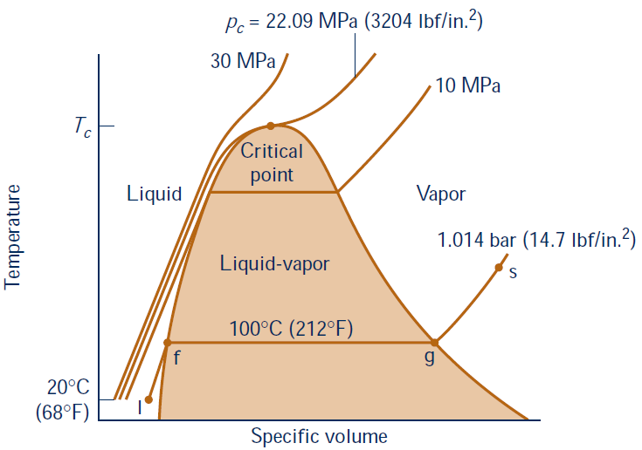




Compressibility Factor
Normalize p and T to determine Z
Reduced pressure,
$$p_{R}=\frac{p}{p_{c}}$$
$$T_{R}=\frac{T}{T_{c}}$$
Reduced temperature,
Example: air: (Table A-1)
p_{c} = 37.7 bars,
T_{c} = 133 K
At p = 37.7 bar,
T = 266 K, then
$$P_{R}=1$$
$$T_{R}=2$$

Slide 16
Generalized Compressibility Chart

Slide 17
Generalized Compressibility Chart
What is the compressibility factor for a gas with a reduced temperature of 1.1 and a reduced pressure of 1?
0.4
0.7
0.8
1.0
1.1

Slide 18
Critical Properties
Notes:
Look at the typical gases and very low Tc and high Pc, so we can use in ideal gas

Slide 19
Example
Find the value of specific volume of methane at 250 K and 10 MPa.

Slide 20
Example
Find the value of specific volume of steam at 400 ºC and 20 MPa using Compressibility Factor.
For water,
p_{c} = 22.06 MPa
T_{c} = 647.1 K
Using steam table we found v = 0.009946 m³/kg
Notes:
3 minutes +
A

Slide 21
Example
Find the value of specific volume of steam at 400 ºC and 20 MPa using Compressibility Factor.
For water,
p_{c} = 22.06 MPa
T_{c} = 647.1 K
Using steam table we found v = 0.009946 m³/kg
Notes:
3 minutes +
A

Slide 22
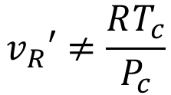

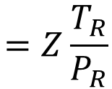
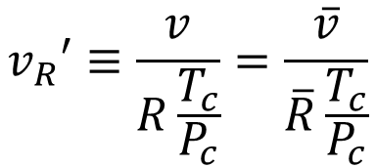
Pseudo-reduced Specific Volume
Sometimes, p and v are given instead, then need to calculate pseudo-reduced specific volume:
$$v_{R}′≡\frac{v}{R\frac{T_{c}}{P_{c}}}=\frac{\overline{v}}{\overline{R}\frac{T_{c}}{P_{c}}}$$
$$\overline{v}=Mv$$
$$=Z\frac{T_{R}}{P_{R}}$$
$$v_{R}′≠\frac{RT_{c}}{P_{c}}$$
For water,
p_{c} = 22.06 MPa
T_{c} = 647.1 K

Slide 23
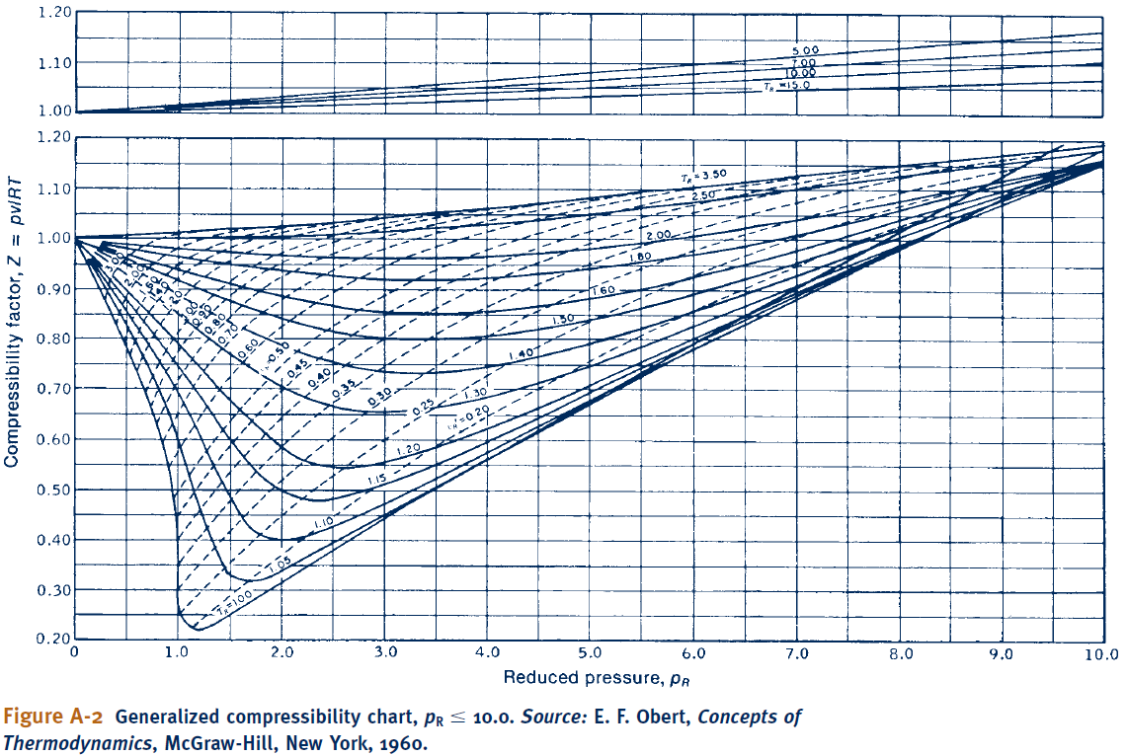
Compressibility Factor
Notes:
Dashed line is reduced volume values

